Slide 1

Procurement Informational Seminar
October 27st & 28th, 2016

Slide 2
AREAS OF INTEREST
Procurement Policies & Procedures
Justification Letters
Contract Administration
Payment Certification
Purchase Order Management and Warehouse Management

Slide 3
ORGANIZATIONAL CHART
ANTHONY D. THOMAS
Territorial Director of Procurement/ Chief of Staff
Roberta Andrews
Administrative Assistant
THOMAS BISHOP
Warehouse Manager
Deviqua Parris
Contract Specialist
Cher Commissiong
Warehouse Manager
COSMORE WHEATLEY
Procurement Assistant
Khadila Joseph
Contract Administrator
Jeanette Ferriere
Receiving Officer
RECIEVING OFFICER
Noel Connors
LABORER
Jesus Diaz
Laborer
DRIVER
Eugene Bell
LABORER
Athniel Blyden
Charleston Creighton
Driver
LABORER
Vern Niles
LINDA MCFARLANE
PO Analyst
Barbara Harvey
Procurement Clerk
Steven Walters
Contract Specialist

Slide 4
WHAT IS “VIDE” PROCUREMENT?
The “Territorial” Division of Procurement has oversight of
all strategic sourcing and purchasing, contract management, and warehouse operations.
Responsible for the approval of Departmental purchases in accordance with local (GVI) and
Federal (FAR) procurement regulations.
Provide technical buying support for Schools and Activity Centers not limited to the purchase
technology equipment, professional services, and building maintenance.
Purchase and Distribution of supplies and materials to various Schools and Activity Centers.
Deliver user friendly procurement methods, training programs, customer service, and support to
all stakeholders (this includes you!!!)

Slide 5

PROCUREMENT POLICIES & PROCEDURES
VIDE Division of Procurement

Slide 6
POLICIES AND PROCEDURES
PRO 2.0 – Procurement Overview
PRO 2.1- Obtaining Sole Source Bids
PRO 2.2- Obtaining Bids for Goods
PRO 2.3- Obtaining Bids for Services
PRO 2.4- New and Re-sent POs
PRO 2.5- Modifying a PO
PRO 2.6- Managing Open POs
PRO 2.7- New Vendor Set-up
PRO 2.8- Vendor Maintenance
PRO 2.9- Vendor Status Modification
PRO 2.10- Outstanding POs
PRO 2.11- Payment Certification * updated
PRO 2.12- Justification Letters * updated
PRO 2.13- Warehouse Supplies & Materials
PRO 2.14 Contract Management* Updated

Slide 7
JUSTIFICATION LETTERS

Slide 8
WHAT IS REQUIRED FOR JUSTIFICATION LETTERS
Goods and Services Under $50,000.00
Goods and Services Over $50,000.00
Addressed to Director of Procurement if ≤ $5,000.00
Addressed to Director of Procurement and Commissioner of Education if ≥$5,000.00
V.I.C. Title 17, Chapter 5, §60d
Supporting Docs i.e. Three (3)quotes, sole source letter, fixed assets form, sam.gov form, proposed agreement
All justification letters should be submitted to procurement@sttj.k12.vi for official receipt
Additional Letter Addressed Commissioner of Department of Property from Commissioner of Education (Standard JL)
V.I.C Title 31, §239
Supporting Docs i.e. Three (3)quotes, sole source letter, fixed assets form, proposed agreement

Slide 9

CONTRACT ADMINISTRATION

Slide 10
CONTRACT MANAGEMENT
What are Contracts?
Request for Proposal
Professional Service Contracts
Memorandum of Agreement/ Understanding
Maintenance Agreements
Hotel and Event Agreements
Maintenance Agreements
Hosting Agreements
The Contractual Process
The contractual process begins with an approved justification letter which should be submitted
at least two months prior to the expected schedule of service.
Gathering of contractual documents, i.e. Business License, Insurance, Certificate of Good Standing
Drafting
Review- Legal Counsel, Program, Contractor
*Execution and Approval

Slide 11
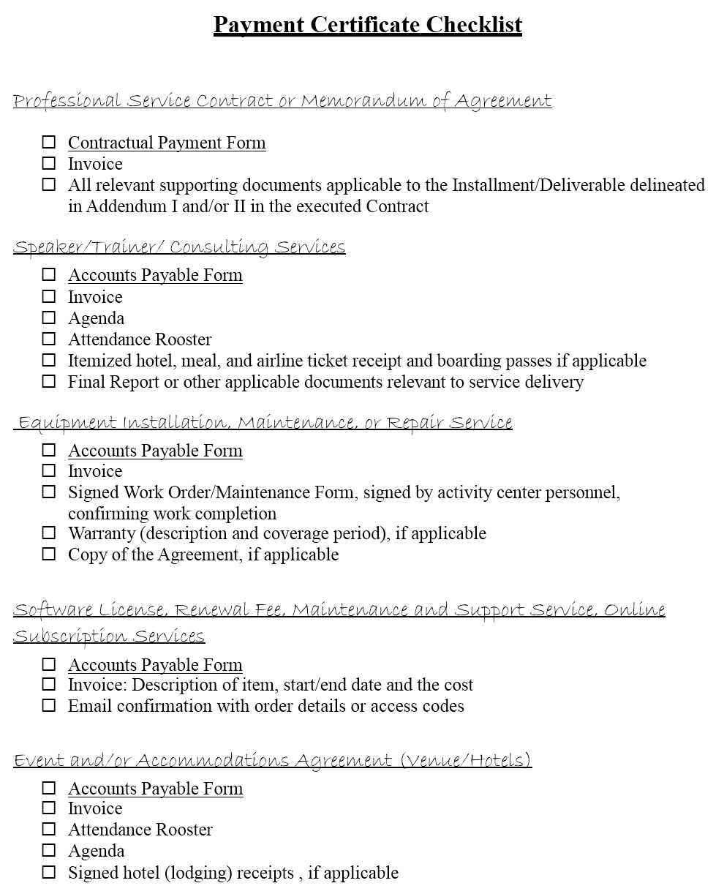
PAYMENT CERTIFICATION

Slide 12
PAYMENT CERTIFICATION
Invoice processing of all federal (and some local) funded services
All invoices with applicable cover letter and supporting documents should be submitted to paymentcertification@sttj.k12.vi
The Payment Approval Process
1. Payment Certification
2. *Internal Audit
3. Accounts Payable
4. VI OMB SCM Unit/ Third Party Fiduciary (Bazilio, Cobb, and Associates)
Accounts Payable From
Contractual Payment Form
Procurement Policy and Procedure 2-11
Event/Hotel
Professional Service Contracts (SFC and GVI)
Memorandum of Agreement(s)
Munis Professional Service Requisitions

Slide 13
PURCHASE ORDER MANAGEMENT
Roles and Responsibilities
Manage outstanding purchase order list and provide vendor/program manager follow-up for all outstanding purchase orders
Document all PO activity on Excel Smartsheet and submit activity on a daily basis
Make contact with 100 vendors or program managers a week (average 20 per day)
Responsible for confirming that the purchase order was received, confirming that the vendor will be able to fulfill all the items on the purchase order, and obtain an approximate date of delivery
Responsible for providing incremental follow-up at minimum 20, 30, 40 and if necessary cancellation and issuance of PO to a vendor with the second best bid
Alert appropriate people when problems with a PO arise, follow up to make sure problem was resolved

Slide 14
PURCHASE ORDER LIQUIDITAION CHALLENGES
Itemizing line items on requisitions
Changing purchase order line items
Including shipping charges in quotes
Separate requisitions for Goods and Services
Timely liquidation of service purchase orders
Timely entering of requisition once quote is received.
Provide clear delineation of payment schedule in grants on purchase order
Prompt resolution to PO’s over 45 days
Authority of PO Management team and Third Party Fiduciary to cancel PO’s over 45 days
Providing accurate information for new vendors
Provide accurate contact information
Communicate vendor contact changes to Purchase Order Management team
Prompt response to emails or phone inquiries
Need for VIDE end users to Manage their Vendors
End users need to make sure that they have correct designated contact and contact’s email in the requisition
Timely response to follow up calls and emails
Timely execution of agree up resolution

Slide 15
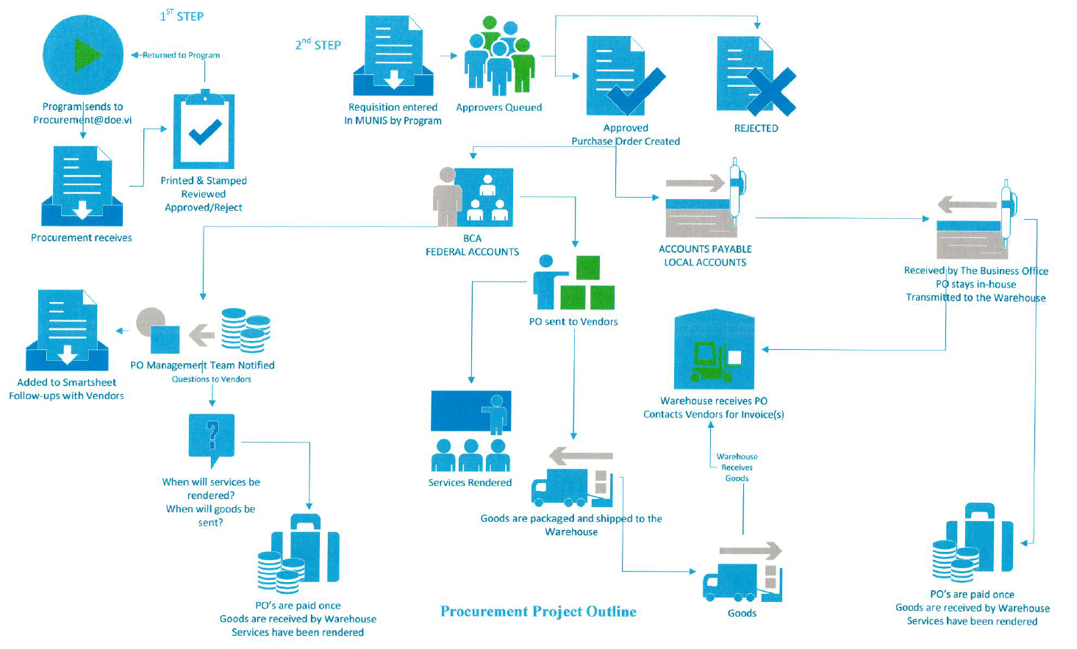
Procurement Workflow

Slide 16
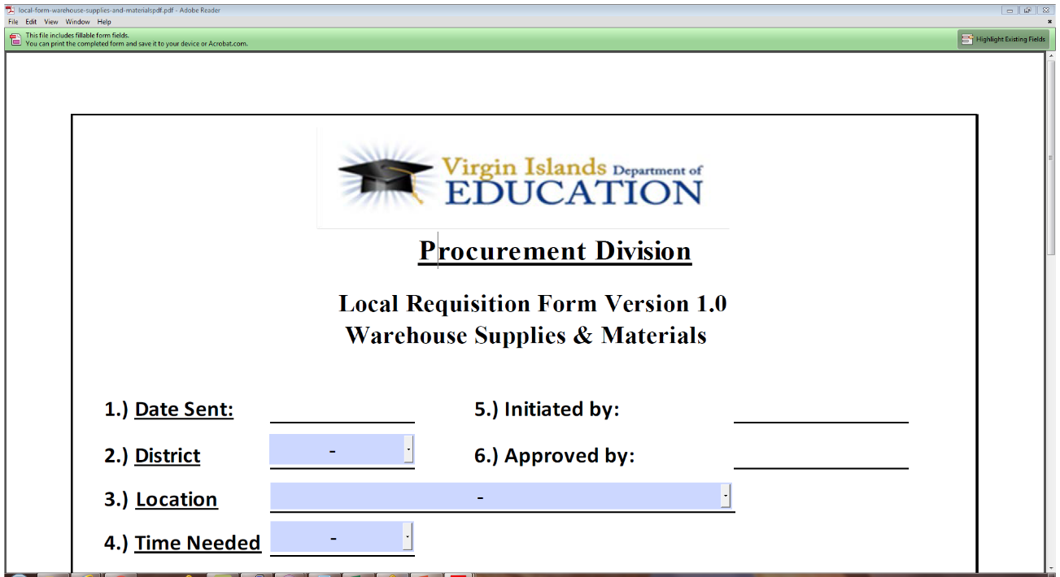
The Warehouse
Responsible for the receipt of supplies and material from vendors for delivery to all schools
and activity centers (excluding the School Lunch Program)
The “Local Requisition Form Version 1.0”should be submitted via email to the respective warehouse
at warehousesttj@sttj.vi.k12 (STTJ) and warehouse2@stx.k12.vi (STX)

Slide 17
Division of Property
(Fixed Asset Management)
Mrs. Takola Creque Forde, Director
Please see handouts currently being distributed
Thank you!!!

