Slide 1
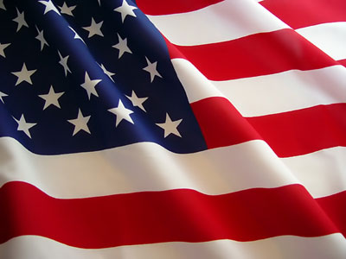
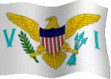
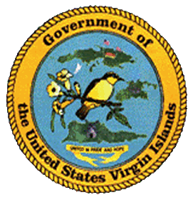


November 2016 Holidays celebrations Recognition
in the United States Virgin Islands
November:
D. Hamilton Jackson Day … Tuesday, November 1st
General Election Day … Tuesday, November 8th
Veterans Day … Friday, November 11th
Thanksgiving Day … Thursday, November 24th
Holidays observed by the United States Virgin Islands
strengthen an important process in the development of the territory.
Compliments of:
Virgin Islands Department of Education
Division of Virgin Islands Cultural Education
Building Our Future Through
Education, History and Culture!

Slide 2
D. Hamilton Jackson Day
D. Hamilton Jackson Day reminds us of our right to freedom of the Press. It was enacted in honor of the tireless effort of D. Hamilton Jackson dating back to 1915 in the Danish West Indies. Mr. Jackson was an editor and publisher of The Herald Newspaper on St. Croix, lawyer, Judge of the Municipal Court of St. Croix, labor leader, and president of the Labor Union Bank on St. Croix. Formerly known as Liberty Day, D. Hamilton Jackson Day – also known as Bull and Bread Day - is celebrated on November 1st in the United States Virgin Islands. The changed legislation approved on July 7, 1981 through Bill #14-0244 Act #4579 reads …
To Amend Chapter 11 of Title 1, Virgin Islands Code, To Change the Name of Liberty Day to D. Hamilton Jackson Day.
WHEREAS David Hamilton Jackson was born on St. Croix on September 28, 1884; and
WHEREAS early in life, Jackson took a keen interest in the affairs of his island, and always stood for what he believed in with courage and conviction; and
WHEREAS he was selected to go to Denmark to represent Virgin Islanders in their effort to convince King Christian X and the Danish Parliament to abolish government control of the press; and
WHEREAS Jackson returned home with the right to a free press and published The Herald, a newspaper; and
WHEREAS David Hamilton Jackson organized one of the first labor unions in the Virgin Islands and was long recognized in the community as an outstanding labor leader; and
WHEREAS Liberty Day is now celebrated in the Virgin Islands on November 1 in observance of the right to a free press; Now, Therefore,
Be it enacted by the Legislature of the Virgin Islands:
Section 1. Title 1, section 171, subsection (a), Virgin Islands Code, is amended as follows:
After the date November 1, strike the words “Liberty Day” and insert in lieu thereof “D. Hamilton Jackson Day”.

Slide 3
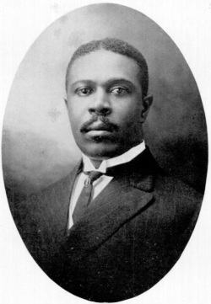
Suggested Family and Classroom Activities:
Research the life of Mr. David Hamilton Jackson
Conduct a discussion about the importance of Mr. D. Hamilton Jackson Day
Attend a celebration of Mr. D. Hamilton Jackson Day observance
Interview a community member about the importance of Mr. Jackson’s work and how he has impacted the lives of the Virgin Islands
Courtesy of
Text: A Teachers Guide to Holiday Observances in the Virgin Islands, page 54; Virgin Islands Cultural Highlights, page 17; Legislative Archives
Pictures: http://www.lovecitycarferries.com/blog/category/Holidays

Slide 4
General Election Day
With the primary election behind us, the locally General Election Day is set for Tuesday, November 8, 20164. It is a day set aside for all bona fide citizens of the United States to exercise their right to vote.
Election Day: Why We Vote When We Vote?
Lots of thought went into Tuesday after the first Monday in November … By Robert Longley
Of course, every day is a good day to exercise our freedom, but why do we always vote on the Tuesday after the first Monday in November? Since 1845, this has been the day designated for holding U.S. presidential and congressional elections.
Why in November? Most Americans made their living from agriculture in 1845 and Congress felt that November was the most convenient month for farmers and citizens living in rural areas to get to the polls. Preparing fields and planting crops consumed lots of the public's time in the spring and summer months. But by early November, the harvest was over in most areas, and the weather was still mild and dry enough to allow travel over the dirt and rock roads of the day.
Why on Tuesday? In 1845, and for many years after that, only the county seats had polling places. For many voters, this meant at least an overnight trip on horseback or buggy. If the election were held on Monday, people would have to leave on Sunday, which in 1845, was reserved for church.
Why the first Tuesday after the first Monday? Congress wanted to make sure the election never fell on the first of November. November 1st is a Holy Day of Obligation in the Roman Catholic Church (All Saints Day). In addition, many businesses tallied their sales and expenses and did their books for the previous month on the first of each month. Congress feared that an unusually good or bad economic month might influence the vote if it were held on the 1st. But, that was then and this is now true, most of us are no longer farmers, and while some citizens still ride a horse to vote, travel to the polls is far simpler than in 1845. But is there, even now, a single "better" day to hold a national election than the first Tuesday after the first Monday in November?
School is back in session and most summer vacations are over. The closest national holiday -- Thanksgiving -- is still almost a month away, and you don't have to buy anybody a gift. But the runaway best all-time reason for holding the election in early November is one Congress never even considered in 1845. It's far enough from April 15 that we have forgotten about the last tax-day and haven't started worrying about the next one.

Slide 5
Outlined below is the guidelines for candidates and voters, as mandated by The Revised Organic Act of 1954 …
For the General Election Day in the US Virgin Islands, the following offices will be elected: Delegate to Congress, Senator at Large, Senators - STX and STT/STJ Districts, Board of Election at Large, and Board of Education - STX and STT/STJ Districts. Their term of office would be two years, which commences on the second Monday in January following the election (Monday, January 9, 2017).
Candidates:
No person shall be eligible to be a member of the legislature who is not a citizen of the United States, who has not attained the age of twenty-one years, who is not a qualified voter in the Virgin Islands, who has not been a bona fide resident of the Virgin Islands for at least three years next preceding the date of his election, or who has been convicted of a felony or of a crime involving moral turpitude and has not received a pardon restoring his civil rights. Federal employees and persons employed in the legislature, executive or judicial branches of the government of the Virgin Islands shall not be eligible for membership in the legislature.
Voters:
No person shall be eligible to vote who is not a citizen of the United States, who has not attained the age of 18 years of age, who has not been a bona fide resident of the Virgin Islands for at least six months proceeding the election, or who has been convicted of a felony or a crime involving moral turpitude and has not received a pardon restoring his civil rights, and a male who has not registered with selective services.
Suggested Family and Classroom
Conduct a mock-election
Allow a child to accompany an adult and participate in the election process
View the candidates debates on local TV stations, such as WTJX and TV2.
Interview the candidates and/or invite them to do a presentation to your school, church, and/or community group
Courtesy of
Text: http://www.vivote.gov/content/voting-trivia-history; http://www.doi.gov/archive/oia/pdf/RevOrganicAct_1954.pdf; Division of Virgin Islands Cultural Education;

Slide 6
Veterans Day
Veterans Day, which is an official federal holiday of the United States of America, is celebrated on November 11th. It serves to honoring and celebrate the service of all U.S. military veterans in all branch of the United States Armed Forces – Air Force, Army, Coast Guard, Marines and Navy.
Originally known as Armistice Day, it was in memory of the end of World War I fighting at 11:00am, November 11, 1918 (the 11th hour of the 11th day of the 11th month). Officially receiving its name in American in 1926 though a Congressional resolution, it became a national holiday 12 year later by similar Congressional action. With the idea of Armistice Day signifying World War I was ‘the War to end all wars”, it might have still been called such. However only a few years after the proclamation of the holiday, war broke out in Europe. Of the 16 ½ million Americans to take part, 407,000 died in service. Hence Armistice Day was changed to honor all veterans with the first celebration termed as Veterans Day in Birmingham, Alabama in 1947. Raymond Weeks, a World War II veteran, organized "National Veterans Day," which included a parade and other festivities, to honor all veterans. The event was held on November 11, the then designated Armistice Day. Later, U.S. Representative Edward Rees of Kansas proposed a bill that would change Armistice Day to Veterans Day. In 1954, Congress passed the bill that President Eisenhower signed proclaiming November 11 as Veterans Day. Raymond Weeks received the Presidential Citizens Medal from President Reagan in November 1982. Weeks' local parade and ceremonies are now an annual event celebrated nationwide. To honor these men, symbolic of all Americans who gave their lives in all wars, an Army honor guard, the 3rd U.S. Infantry (The Old Guard), keeps day and night vigil. A law passed in 1968 changed the national commemoration of Veterans Day to the fourth Monday in October. It soon became apparent, however, that November 11 was a date of historic significance to many Americans.
National ceremonies are held at Arlington National Cemetery with officials at the memorial amphitheater built around the Tomb of the Unknows. Precisely at 11:00am on November 11th, a combined color guard representing all military services executes “Present Arms” at the tomb. The nation’s tribute to its war dead is symbolized by the laying of a presidential wreath. The bugler plays “taps.” The rest of the ceremony takes place in the amphitheater. Veterans Day ceremonies at Arlington and others are coordinated by the President’s Veterans Day National Committee. Chaired by the Secretary of Veterans Affairs, the committee represents national veterans organizations. Governors of many states and U.S. territories appoint Veterans Day chairpersons who, in cooperation with the National Committee and the Department of Defense, arrange and promote local ceremonies.
In the United States Virgin Islands, parades are held in all three islands – St. Croix, St. John, and St. Thomas to pay special tributes to our veterans. Parades are held at alternate times of the day. Participants in the parade include armed forces veterans, elected officials to include the Governor and Lieutenant Governor of the United States Virgin Islands, Delegate to Congress, Senators, public Schools bands and their JROTC, Junior Fire Fighters, Boys and Girls Scouts, Seventh-day Adventist Church Youth Ministries (Adventist Youth, Pathfinder, Adventurers, and Eager Beavers). Following the parades, special ceremonies with noted guest speakers are held on all three islands. On St. Croix they are held at the Buddhoe Park in Frederiksted and the Basin Triangle in Christiansted; on St. John they are held on Coral Bay and Cruz Bay; and on St. Thomas at the Franklin Delano Roosevelt Veterans Memorial Park.

Slide 7
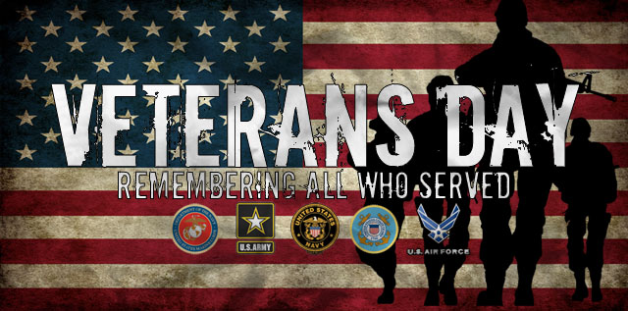
Suggested Family and Classroom Activities:
Research the origin of Veterans Day
Attend and/or participate in a Veterans Day Parade and ceremony
Interview a veteran about his/her experience serving our country
Organize a special Veterans Day activity and invite a veteran to show your appreciation for what they had done / are doing
Prepare and share a special package with a veteran overseas
Courtesy of
Text: http://www.va.gov/opa/publications/celebrate/vetday.pdf
Picture: http://www.c-i-t.com/happy-veterans-day-and-marine-scholarship-foundation/

Slide 8
Thanksgiving Day
Among the first celebration of Thanksgiving Day was held in 1621 when the Plymouth colonists and Wampanoag Indians shared an autumn harvest feast. It offered thanksgiving to the Almighty God for bountiful harvest.
In September 1620 about 102 passengers aboard the Mayflower, a small ship, left Plymouth in search of a new home to freely practice their religious faith, as well as others seeking an opportunity for prosperity and land ownership in the New World. Their 66 days treacherous and uncomfortable journey dropped them near the tip of Cap Cod, which is far north of their destination. A month later, the Mayflower crossed Massachusetts Bay where the Pilgrims (as they known) occupied the village at Plymouth. With the impending first brutal winter, many remained on board the ship and suffered from outbreaks of contagious diseases which lead to about half of their death. As they went ashore, they were greeted by Abenaki Indian and Native American speaking English who taught them to cultivate corn, extract sap from maple trees, catch fish in the rivers, and avoid poisonous plants. In November 1621 after the Pilgrims’ first corn was harvested a celebratory feast was held with the Native American allies (colonists and Indians) and Wampanoag chief. As part of their meals were not pies, cakes, or other desserts, rather their harvested crops, lobster, seal, swans, and deer. What is known as Thanksgiving Day was first celebrated in Plymouth Rock, Plymouth, Massachusetts in November 1621 and then in 1623 to mark the end of the long drought that threatened their harvest and pushed Governor Bradford to call for a religious fast.
It was in 1789 that President George Washington issued the first Thanksgiving proclamation. Its purpose was for all Americans to express their gratefulness to the country’s war of independence and the successful ratification of the US Constitution. Both Presidents John Adams and James Madison designated days of thanks during their tenure. In 1817 New York became the first of several states to officially adopt an annual Thanksgiving holiday. Ten years later in 1827, Sarah Josepha Hale (an author, noted magazine editor, prolific writer) launched a campaign to establish Thanksgiving as a national holiday. Taking heed in 1863 at the height oft the Civil War President Abraham Lincoln in a proclamation asked all Americans to ask God to “commend to his tender care all those who have become widows, orphans, mourners or sufferers in the lamentable civil strife” and to “heal the wound of the nation.” He scheduled Thanksgiving for the final Thursday in November and it was celebrated as such until 1939 when President Franklin D. Roosevelt moved the holiday up a week in an attempt to spur retail sales during the Great Depression. Opposed by many in 1941 he reluctantly signed a bill making Thanksgiving the fourth Thursday in November.
The traditional of Thanksgiving Day, which will be celebrated on the fourth Thursday of November (November 25th), is a day where family and friends gather together to give thanks for what they have and for the many blessings they have received throughout the year. In the US Virgin Islands, this day is used as an opportunity to assist the less fortunate of our community by sharing care baskets and a meal with them. Family and friends also gather together with big meals in celebration. In addition, many churches hold church services as means of giving thanks to the Almighty for His countless blessings.

Slide 9
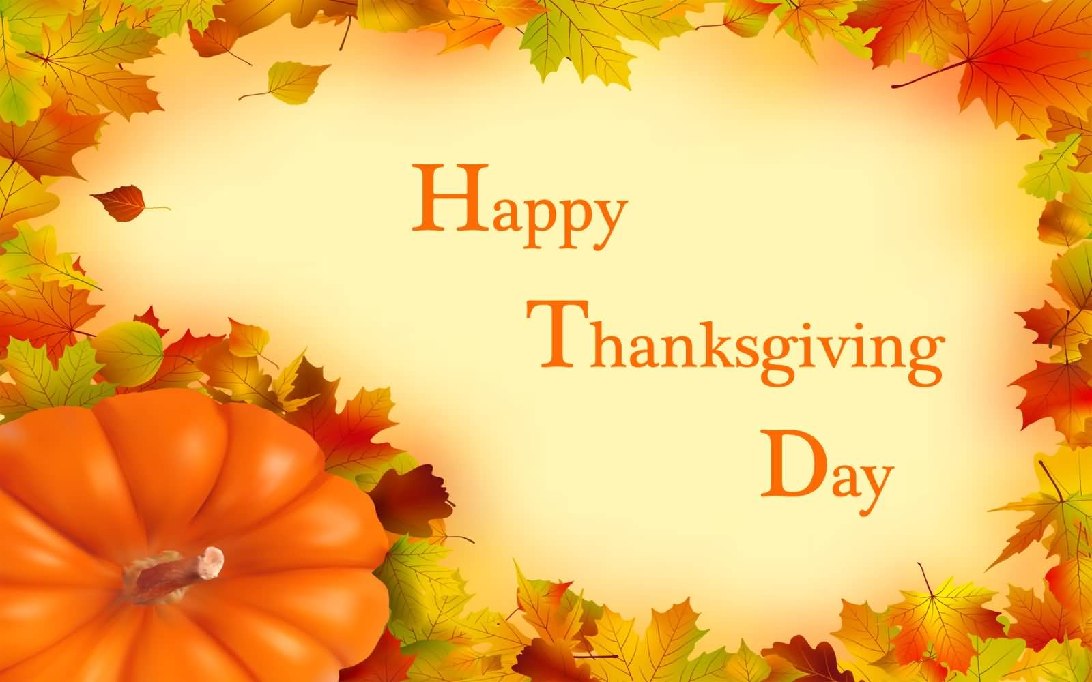
Suggested Family and Classroom Activities:
Research the origin of Thanksgiving Day and share what you learn with your family and friends
Participate in Thanksgiving Day celebration, such as church service and/or feeding the less fortunate project
Organize a drive to assist the less fortunate and elder of our community (for example, a can drive, clothing and/or toiletry collection)
Prepare and deliver care packages for the less fortunate in your neighborhood, school, and/or an elderly
Courtesy of
Text: http://www.history.com/topics/thanksgiving/history-of-thanksgiving
Pictures: https://www.askideas.com/happy-thanksgiving-day-2016-picture/

Slide 10
To receive monthly complimentary electronic holiday / celebration recognitions, kindly contact …..
Virgin Islands Department of Education
Division of Virgin Islands Cultural Education
ST. CROX
2133 Hospital Street; St. Croix, VI 00820
Telephone Number: 340-773-1095 x: 7032
Fax Number: 340-773-4476
ST. THOMAS / ST. JOHN
Mailing Address: 1834 Kongens Gade; STT, VI 00802
Physical Address: J. Antonio Jarvis Annex; STT, VI 00802
Telephone Number: 340-774-0100 x: 2808, 2806, or 2804
Fax Number: 340-777-4342
Email Addresses: vbryson@stx.k12.vi; mmartin@sttj.k12.vi; Yohance.henley@vide.vi
Building Our Future Through
Education, History and Culture!

