Slide 1
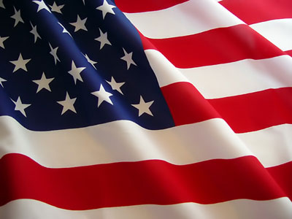
NOVEMBER 2017
HISTORICAL CULTURAL CALENDAR
DEPARTMENT OF EDUCATION
DIVISION OF VIRGIN ISLANDS CULTURAL EDUCATION
Building Our Future Through
Education, History and Culture!

Slide 2
SPECIAL FEATURE
LOCAL PASTRIES
Cashew Sugar Cake … Dundersla
Courtesy of
Picture: Division of Virgin Islands Cultural Education

Slide 3
SPECIAL FEATURE
LOCAL PASTRIES
Peanut Cakes … Peppermint
Courtesy of
Picture: Division of Virgin Islands Cultural Education

Slide 4
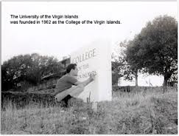
November 1st:
1966:
The then College of the Virgin Islands awarded the lowest bid in the amount of $1,743,446.00 to The Harada Corporation of Puerto Rico to build a woman’s dorm, housing, and the library at College of the Virgin Islands.
Courtesy of
Text: Virgin Islands Daily News, November 1, 1978, page 8
Picture: http://www.uvi.edu/about_UVI-History.aspx

Slide 5
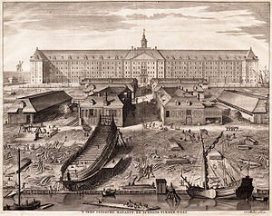
November 2nd:
1670:
The second Danish East India Company was formed and given a charter for forty years. It was formed in order to break the Portuguese and Spanish monopoly in the Far East. The first company was chartered in 1616.
Courtesy of
Text: Today in VI History
Picture: http://en.wikipedia.org/wiki/Dutch_East_India_Company

Slide 6
November 3rd:
1994:
The Virgin Islands Legislature approved a bill, which passed 9-6, to legalize casino gambling on St. Croix. All six dissenting votes were from St. Thomas / St. John. This bill was signed into law and became known as the 1995 Casino Control Act.
Courtesy of
Text: Umbilical Cord Second Edition, Harold W. L. Willocks, pages 467 & 468
Picture: www.facebook.com

Slide 7
November 4th:
1966:
General Louis B. Hershey, head of the National Selective Service, visited and toured VI Selective Service Headquarters. ACLU Lawyer Maruin Karpatkin lashed out at the Mortar & Pestle Democrats at the Loyalty Oath. It violated the first Amendment of the USC & the Revised Organic Act.
Courtesy of
Text: Virgin Islands Daily News, November 4, 1978, page 12 by John M. Hennessy
Picture: http://www.sss.gov/sssyou/sssyou.htm

Slide 8
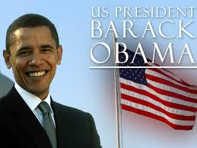
November 5th:
2008:
The leaders of the Territory hailed the election of President Barack Obama - the Nation’s 44th President - as a step forward for the Nation and the US Virgin Islands.
Courtesy of
Text: Virgin Islands Daily News, November 3, 2008, page 3
Picture: http://www.hdwpapers.com/us_president_barack_obama_wallpaper-wallpapers.html

Slide 9
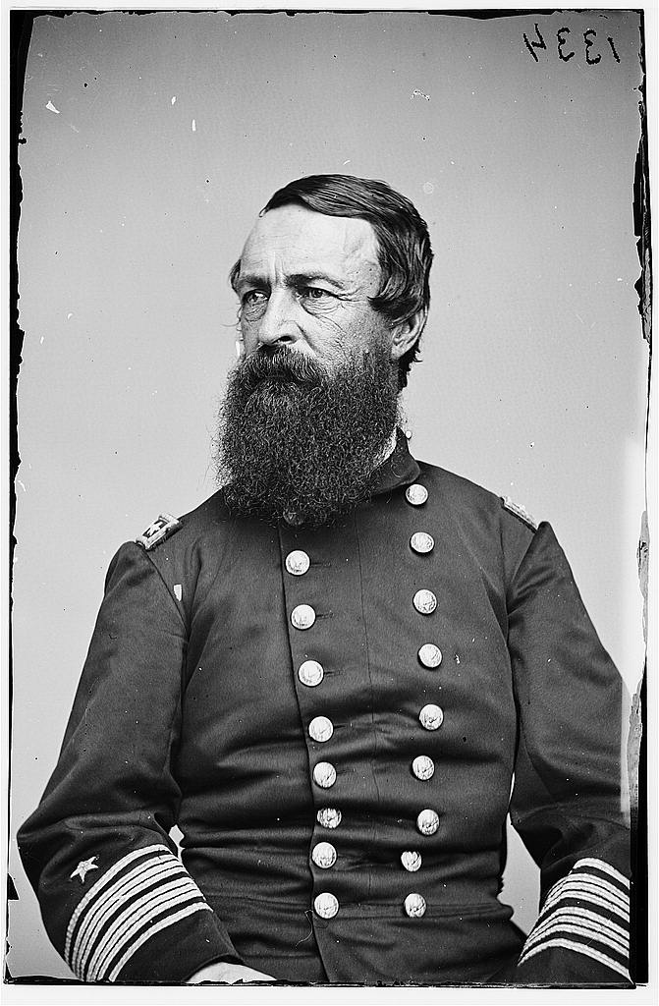
November 6th:
1887:
Navy Vice Admiral David D. Porter in a letter to Secretary of State William H. Seward emphasized the importance of acquiring the Danish West Indies as a naval station.
Courtesy of
Text: Today in VI History
Picture: http://www.civilwarphotos.net/files/images/703.jpg

Slide 10
November 7th:
2000:
The voters of the Virgin Islands voted to reduce the size of the US Virgin Islands Legislature from 15 to 9. This referendum was to be sent to Congress petitioning an amendment to the 1954 Revised Organic Act allowing to change the number of seats in the Virgin Islands Legislature.
Courtesy of
Text: Umbilical Cord Second Edition, Harold Willocks, page 463
Picture: http://politicker.com/2012/10/nyc-to-help-the-homeless-vote/

Slide 11
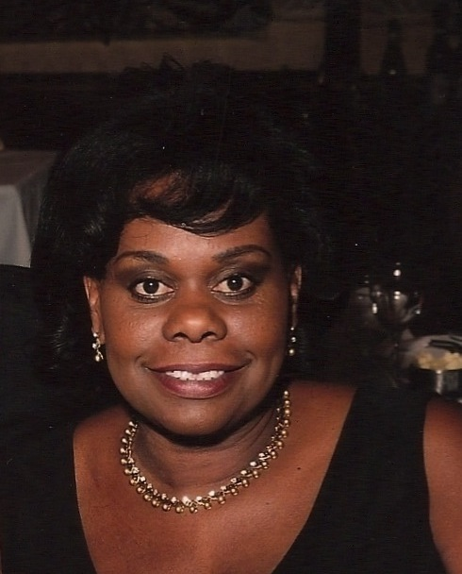
November 8th:
2010:
St. Thomas native artist Dixie Lee Hedrington-Miller showcased her artworks in “A Journey Into My World of Art”. She took readers on a Caribbean tour in her first released book.
Courtesy of
Text: The Virgin Islands Daily News, November 9, 2010, page 20
Picture: https://caribbeanartforyou.see.me/element/1705029/

Slide 12
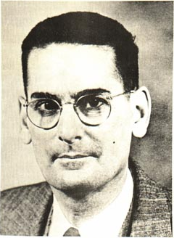
November 9th:
1949:
Governor Morris Fidanque deCastro approved the new Wage and Hour Act. It provided minimum rates of pay for skilled laborers at $0.65 per hour, unskilled at $0.40 per hour, sales and service clerks at $.30 and utility workers not less than $0.20.
Courtesy of
Text: Photo News, November 10, 1949, page 1
Picture: http://www.zeably.com/Morris_Fidanque_de_Castro

Slide 13
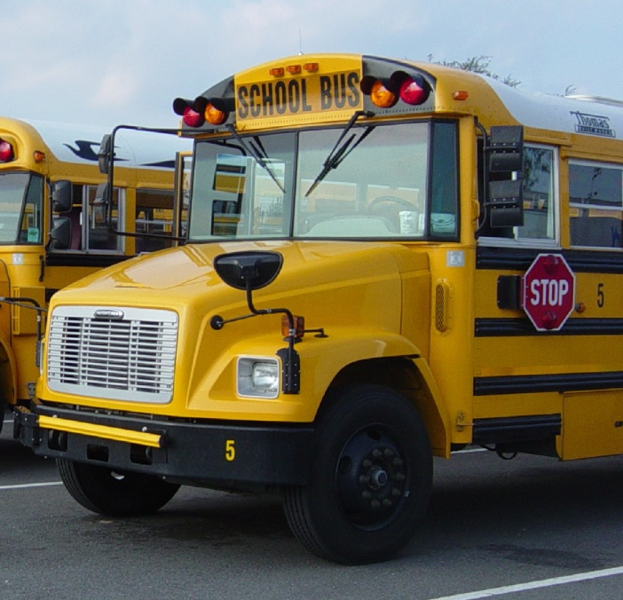
November 10th:
1949:
The Legislature voted to purchase the first school bus for country students to be transported to and from school.
Courtesy of
Text: Photo News, November 14, 1949
Picture: http://www.camden.k12.ga.us/

Slide 14
November 11th:
1908:
Emile Augustus “Milo” Jurgen was born on St. John. As a musician he played the accordion and guitar. He was noted to be captured in a film demonstrating how to prepare a coalpit to produce coal.
Courtesy of
Text & Picture: Funeral booklet

Slide 15
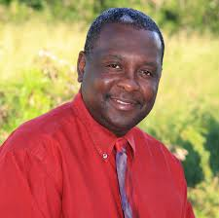
November 12th:
2009:
The Daily News announced St. Croix Central High School Math teacher, Moordale Bryan was named the top teacher in the territory for the 2009-2010 school year. As part of his prize, he would travel to Washington DC and be honored by President Barack Obama.
Courtesy of
Text: The Virgin Islands Daily News, November 12, 2009, page 4
Picture: https://plus.google.com

Slide 16
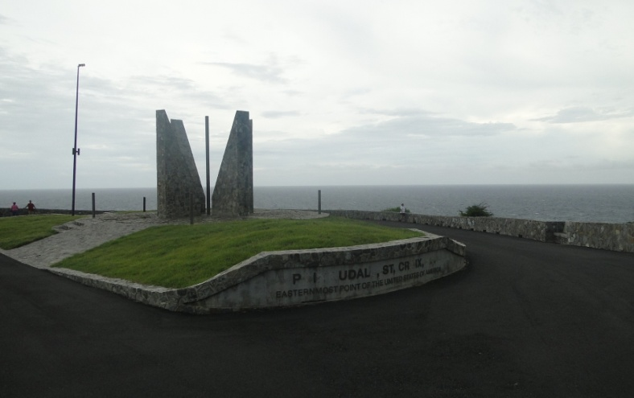
November 13th:
1968:
Resolution #432 was passed by the 7th Legislature to rename East Point, St. Croix to Point Udall. It was to honor Stewart L. Udall, Secretary of the Interior, who served under Presidents John F. Kennedy & Lyndon B. Johnson.
Courtesy of
Text: Legislative Archives
Picture: Division of Virgin Islands Cultural Education

Slide 17
November 14th:
1683:
Leeward Islands governor William Stapleton was authorized to seize Adolph Esmit, governor of St. Thomas, and put an end to his blatant acts of corruption.
Courtesy of
Text: Today in VI History
Picture: http://www.britishempire.co.uk/maproom/leewardislands/leewardislandsadmin.htm

Slide 18
November 15th:
1903:
Harry B. Reubel, the first Virgin Islander to achieve the rank of Lieutenant Colonel in the US Army, was born on St. Croix, USVI.
Courtesy of
Text: Today in VI History
Picture: http://pacificislandparks.com/2012/02/08/african-american-liberators/

Slide 19
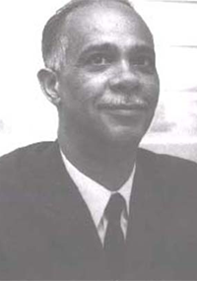
November 16th:
1913:
Roy Adelbert Anduze was born on St. Thomas, USVI. He was a physician, surgeon, Fellow in Surgery at Howard University, Chief Municipal Physician and Commissioner of Health, Fellow in the American Colleges of Surgeons and Angiology, Delegate to the UN General Assembly to present, “Health in Non-Self Governing Territories” and DVI Board of Trustees member.
Courtesy of
Text: Profiles of Outstanding Virgin Islanders, Ruth Moolenaar, pages 5 and 6
Picture: http://www.healthvi.org/about/comissioner/previous-comissioners/anduze.html

Slide 20
November 17th:
1978:
The Remy Martin Caribbean Backgammon Championships - 5 day backgammon tourney - was held at Sugar Bird Hotel on the Waterfront. More than half of the players were from across the US Mainland. The categories included open, intermediate and doubles.
Courtesy of
Text: The Virgin Islands Daily News, November , 1978, page 28
Picture: https://play.google.com/store/apps/details?id=com.games.backgammonfull

Slide 21
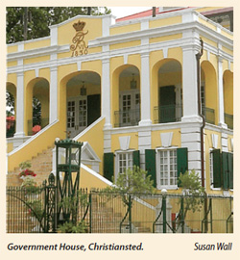
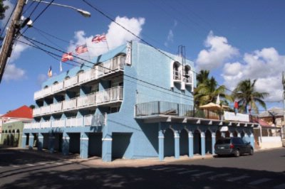
November 18th:
2008:
It was announced that the St. Croix historical towns of Christiansted and Frederiksted were honored by First Lady Laura Bush, Honorary chair of the Preserve America initiative.
Courtesy of
Text: http://www.caribbeannewsnow.com/caribnet/usvi/usvi/php?news
Picture: http://www.stcroixthisweek.com/featured-articles/celebrating-our-historic-architecture.html; http://www.hotelplanner.com/Hotels/3464-NEAR-Christiansted-Henry-E-Rohlsen-Airport-STX

Slide 22
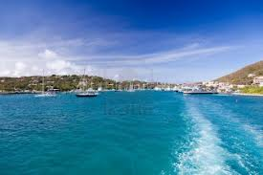
November 19th:
1978:
The first power boat regatta was held starting in the St. Thomas harbor. It went around the entire island in three classes of races.
Courtesy of
Text: The Virgin Islands Daily News, November 23, 1978, page 24
Picture: http://www.123.com

Slide 23
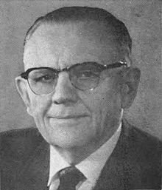
November 20th:
1964:
The 5th Legislature of the Virgin Islands approved the naming of a public junior high school in honor of Wayne N. Aspinall of Colorado. He was a member of the US House of Representatives and chairman of the House Interior and Insular Affairs Committee and served the people of the VI with notable distinction.
Courtesy of
Text: www.webpac.uvi.edu/imls/pi-uvi/historical_notes_on-schoolds.pdf
Picture: http://en.wikipedia.org/wiki/Wayne_N._Aspinall

Slide 24
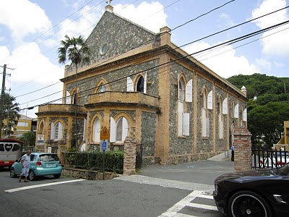
November 21st:
1848:
All Saints Cathedral was dedicated by the Bishop of Antigua, Daniel Gateward Davis.
Courtesy of
Text: The Virgin Islands Daily News, Celebrating Freedom A Black History Month Special Supplement, February 3, 1998, page BH-9
Picture: http://bish-randomthoughts.blogspot.com/2010_07_01_archive.html

Slide 25
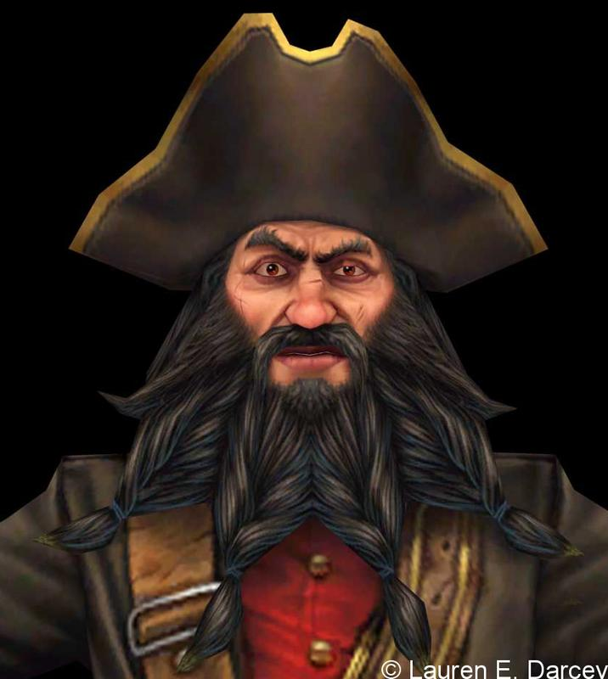
November 22nd:
1718:
The notorious English pirate Edward Teach, known as Blackbeard, was killed during a battle just off the coast of North Carolina. The Blackbeard’s Castle on St. Thomas is named after the pirate.
Courtesy of
Text: Today in VI History
Picture: http://pophaydn.wordpress.com/2011/09/18/blackbeard-the-pirate/

Slide 26
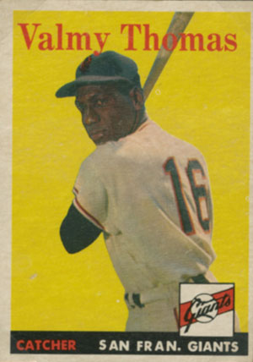
November 23rd:
1949:
The Photo News cited Crucian Valmy Thomas - the first Virgin Islander to play professional baseball - as the youngest Virgin Islander to play baseball in the Puerto Rico League.
Courtesy of
Text: Photo News, November 23, 1949, page 2
Picture: http://www.mcny.org/glorydays/inning-1/chart/

Slide 27
November 24th:
1927:
Pearl White Creque was born on St. Thomas. As the first authorized “Phillips Electronics” dealer in the USVI, she owned and operated “Creque Record and Appliance Shop”.
Courtesy of
Text & Picture: Funeral booklet

Slide 28
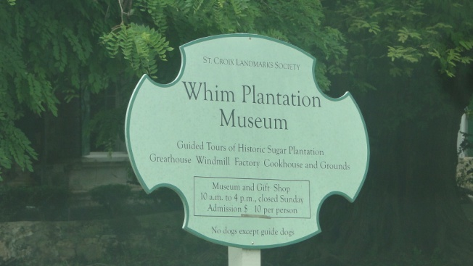
November 25th:
2007:
The Avis reported that once again John H. Mudle added to the already extensive historical collection of St. Croix artifacts and literatures on display at Whim Museum. He donated a pair of silver mugs made in 1774. He also donated copies of his historical book, “A West Indies Melodrama” to the St. Croix Landmarks Society.
Courtesy of
Text: The Avis, November 25 – 26, 2007, page 2
Picture: Division of Virgin Islands Cultural Education

Slide 29
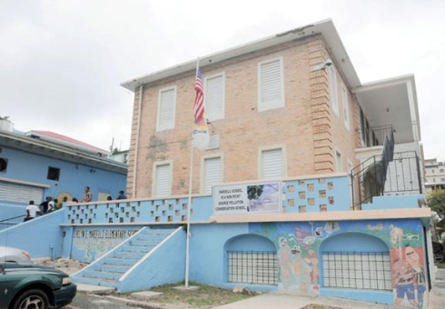
November 26th:
1973:
The 10th Legislature approved Act #5303 to mandate the renaming of the George Washington School, the Evelyn E. Marcelli Elementary School. It was a lasting tribute to Ms. Evelyn E. Marcelli’s devotion of her considerable talent and energies to the benefit of the public education system of the Virgin Islands.
Courtesy of
Text: www.webpac.uvi.edu/imls/pi-uvi/historical_notes_on-schoolds.pdf
Picture: http://virginislandsdailynews.com/news

Slide 30
November 27th:
1889:
Amadeo Ignacio Daniel Francis, Sr. was born on St. Croix. He was a veteran educator from Danish rule into several decades of American rule.
Courtesy of
Text & Picture: Profiles of Outstanding Virgin Islanders, Ruth Moolenaar, page 74

Slide 31
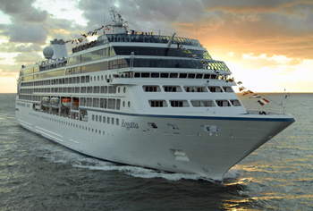
November 28th:
2008:
St. Croix welcomed the first cruise ship of the season when the Oceania Regatta made its inaugural visit at the Ann E. Abraham Marine Facility in Frederiksted, St. Croix. In a private “Plaque and Keys” ceremony, Tourism Commissioner Beverley Nicholson-Doty presented a plaque to the ship’s captain to commemorate its inaugural visit to St. Croix.
Courtesy of
Text: http://www.caribbeannewsnow.com/caribnet/usvi/usvi.php?news
Picture: http://cruisediva.com/Oceania%20Regatta%20in%20Europe.htm

Slide 32
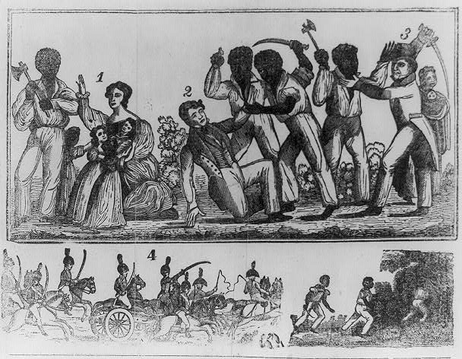
November 29th:
1734:
Desperate St. Thomas and St. John Governor Philip Gardeline wrote to Philip Markoe, Deputy Governor of Spanishtown, Virgin Gorda, requesting assistance in quelling the slave rebellion on St. John from the previous November.
Courtesy of
Text: Today in VI History
Picture: https://www.boundless.com/u-s-history/slavery-and-reform-1820-1840/anti-slavery-resistance-movements/nat-turner-s-rebellion/

Slide 33
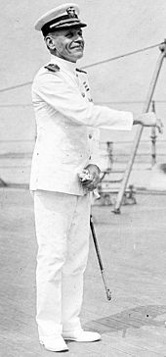
November 30th:
1869:
Martin Edward Trench, the seventh appointed governor of the US Virgin Islands under Naval Rule, was born in Dennison, Minnesota.
Courtesy of
Text: Today in VI History
Picture: http://commons.wikimedia.org/wiki/File:MartinEdwardTrench.jpg

Slide 34
To receive monthly complimentary electronic historical cultural calendar,
kindly contact …..
:
Division of Virgin Islands
Cultural Education
ST. THOMAS / ST. JOHN
Mailing Address: 1834 Kongens Gade, STT, VI 00802
Physical Address: J. Antonio Jarvis Annex, STT, VI 00802
Telephone Number: 340-774-0100 x: 2804, 2806, 2808, or 2809
Fax Number: 340-777-4342
Email Addresses: yohance.henley@vide.vi, mmartin@vide.vi; or vbryson@vide.vi.
Building Our Future Through
Education, History and Culture!

